Slide 1

School of Technology, Design and Computer Application Silver Oak College of Compter Application
Department of Computer Application
A PROJECT PRESENTATION ON
AI Finance Platform
Submitted By
Parate Dhvanit D (EnNo:
2204030102153)
Solanki meet V (EnNo:2204030102644)
Zapadiya Rahul J (En no.: 2204030102835)
Bachelor of Computer Application Semester VI
Group No: 26
Guide
Ms. Vaishali Patel

Slide 2


1. PROJECT PROFILE
Project Profile: | AI Finance Platform
Objective: | Automate financial tracking using AI (GEMINI API). Manage budgets, transactions, and generate alerts/reports.
Platform of Application: | Web base Application
Front End Tool: | Next JS (For both Client side and Server side)
Back End Tool: | Supabase Database, Clerk Authenatication
Project Duration : | 6 Months
Project Guide : | Mrs Vaishali Patel
Submitted By : | Parate Dhvanit : 2204030102153 Solanki Meet : 2204030102644 Zapadiya Rahul : 2204030102835
Submitted To : | Department Of Computer Application 2

Slide 3

2. EXISTING SYSTEM
Most financial tracking systems require manual input of transaction details.
Receipt data needs to be manually which is time-consuming and error-prone.
Budget tracking often requires separate spreadsheets or applications.
Many existing systems lack intelligent notification systems for budget overruns.
Limited AI integration for automating financial data extraction.
User need to check their budgets manually to avoid overspending.
3

Slide 4
3. NEED FOR NEW SYSTEM
Automated receipt scanning saves time and reduces data entry errors.
Integrated transaction management and budget tracking in a single platform.
Proactive budget alerts to prevent overspending (email alerts at 80% threshold).
AI-powered data extraction for faster and more accurate financial record keeping.
Automated monthly financial reports generation.
Responsive design that works across all devices.
4

Slide 5




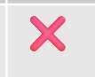

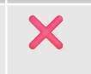



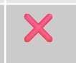

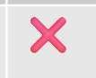

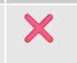













COMPARATIVE ANALYSIS
Features | Mint | YNAB | Personal Capital | AI Finance Platform
UI & UX
Receipt Scanning
Budget Alerts
AI Integration
Monthly Reports
Authentication
Free to Use

Slide 6
FUNCTIONAL SPECIFICATION
4.1 USER OF THE SYSTEM
Regular User:-
The user can register and log in to the system using clerk Authentication.
The user can scan receipt and add transaction automatically.
The user can add, edit, and delete transactions manually.
The user can set and manage monthly budgets.
The user can view transaction statements and records.
The user receives email alerts when budget reaches 80% threshold.
The user receives monthly financial reports.
6

Slide 7
4. FUNCTIONAL SPECIFICATION
4.1 USER OF THE SYSTEM
Admin:-
The admin can log into system with admin credentials.
The admin can view system usage statistics.
The admin can manage user accounts.
The admin can troubleshoot issues.
7

Slide 8
4. FUNCTIONAL SPECIFICATION
4.2 MODULE OF THE SYSTEM
Authentication Module :-
Users can register and log in securely using clerk authentication.
Receipt Scanner Module :-
Users can scan receipt to automatically extract and add transaction data.
Transaction Management Module :-
Users can add, edit and view transaction details.
Budget Management Module :-
Users can create and manage monthly budgets across different categories.
8

Slide 9
4. FUNCTIONAL SPECIFICATION
4.2 MODULE OF THE SYSTEM
Notification System :-
System sends budget alerts and monthly reports via email.
Report Generation Module :-
System generates detailed monthly financial reports.
9

Slide 10

5. SYSTEM REQUIREMENT
5.1 MINIMUM SOFTWARE REQUIREMENT
Server Side Requirement
Operating System | Linux /Window Server
Web Server | Node.js
Front-End Tools | Next,js, React, Tailwind CSS
Back-End Tool | Supabase.
Client Side Requirement
Operating System | Any OS with modern web browser.
Web Browser | Google Chrome, Firefox, Safari, Brave etc.
10

Slide 11
5. SYSTEM REQUIREMENT
5.2 MINIMUM HARDWARE REQUIREMENT
Server Side Requirement
Processor | 2.0 GHz or higher
RAM | 4 GB or Higher
Hard disk | 20 GB(Free Space)
Client Side Requirement
Processor | 1.6 GHz
RAM | 4 GB
Hard disk | 5 GB(Free Space)
11

Slide 12
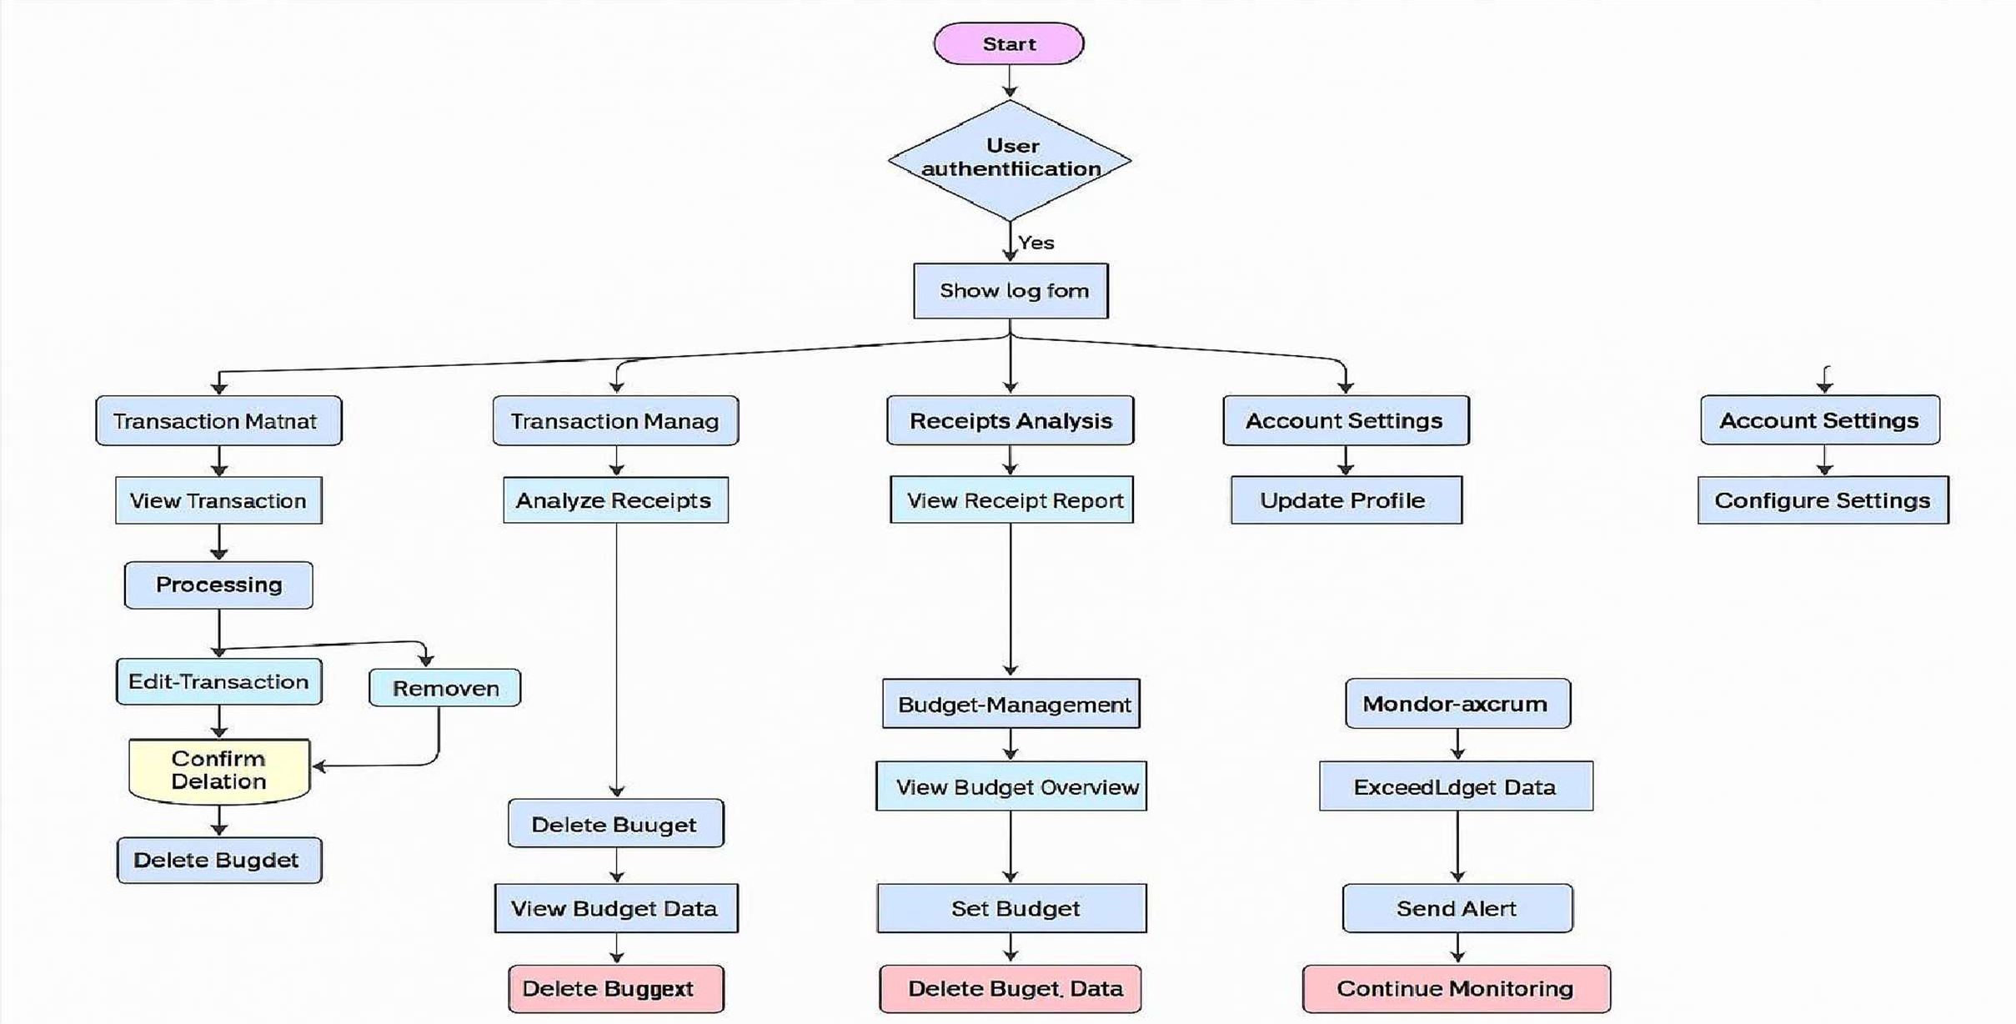
6. SYSTEM FLOWCHART

Slide 13
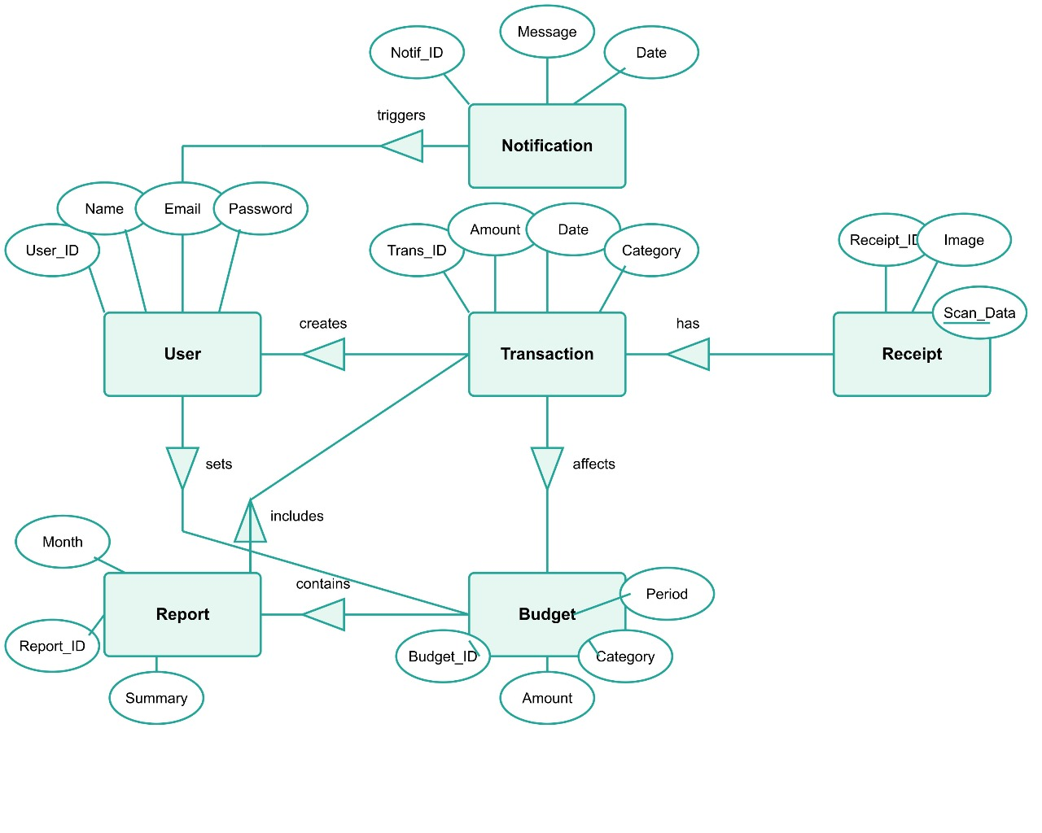
7. ER DIAGRAM

Slide 14
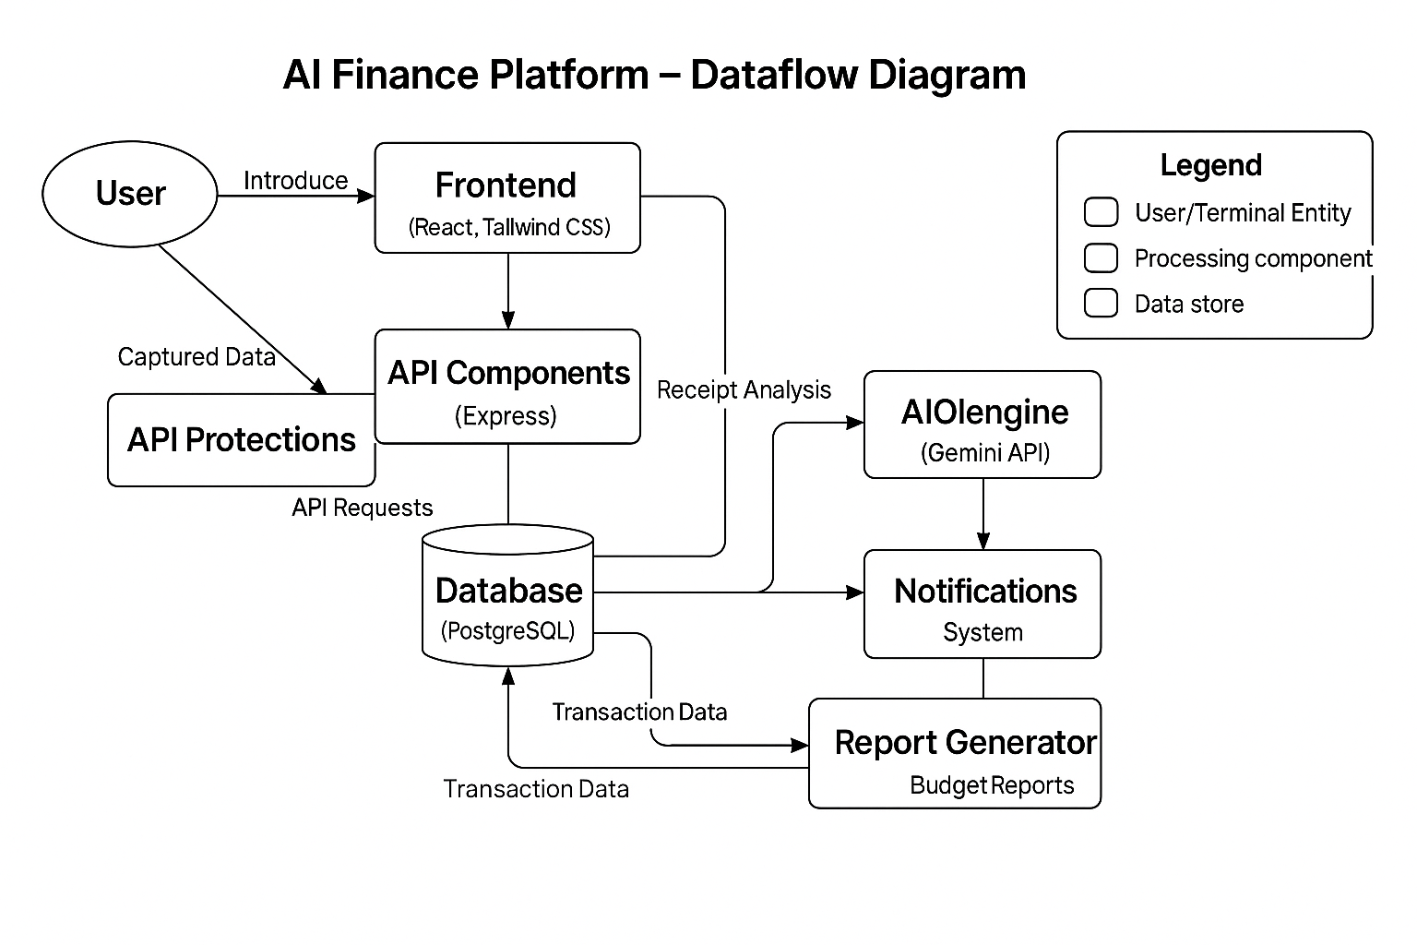
8. DATAFLOW DIAGRAM
14

Slide 15
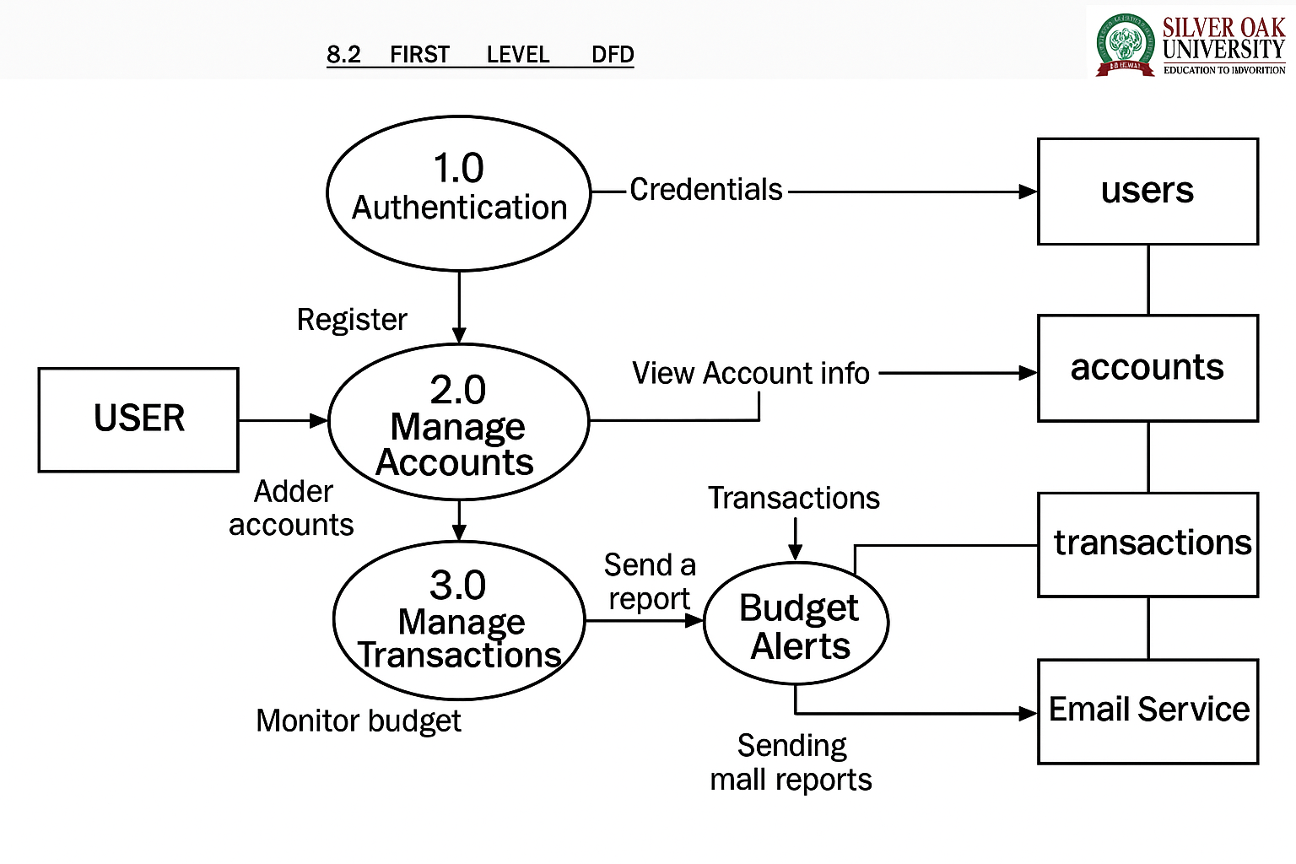
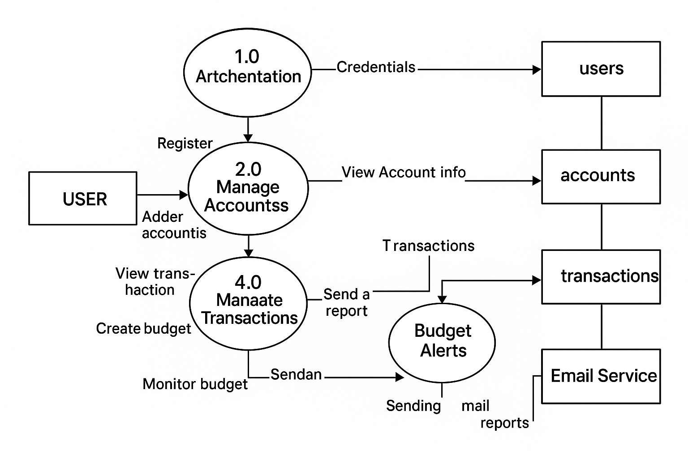
8.2 FIRST LEVEL DFD

Slide 16
9. DATA DICTIONARY
TABLE NAME
users
accounts
budgets
transactions
16

Slide 17

Users
Table Name : - | users
Primary Key : - | user_id
Description : - | To store user information
Sr. No | id | ClerkUserId | email | name | createAt
1 | 107eb73c-beee- 4db1-b2b8- 3a5b9e259cd6 | user_2skKGwvqb nc2jW5dv5IYKn35 3iP | paratedhvanit@gmail.com | Dhvanit Parate | 2025-02-04 16:01:07.938
2 | c8f06132-08c0- 4cb3-a033- ca23cb41182e | user_2sToAYnLCj Cvx4iTTZAS7ryEv QK | dhvanitparate123@gmail. com | Dhvanit Parate | 2025-02-03 12:13:29.027
3 | 25a17f1e-d6b4- 4e5a-a468- 64b841f3f011 | user_2vASZZqJdH t2ixMbHpMZlfPw 135 | rahulzapadiya022@gmail.c om | Rahul zapadiya | 2025-04-02 09:34:47.263

Slide 18
Accounts
Table Name : - | accounts
Primary Key : - | account_id
Description :- | To store accounts Information in Details.
no | id | name | type | Balance | userid | createdAt
1 | 598d5b1e-597a- 4018-a7b4- fdc5ad4a677f | Work | CURRENT | 1000 | c8f06132-08c0-4cb3-a033- ca23cb41182e | 2025-02-12 05:44:11.78
2 | da65d212-1c37- 4be3-aeb3- c3709bc7e6d8 | Dhvanit | SAVINGS | 189892.83 | c8f06132-08c0-4cb3-a033- ca23cb41182e | 2025-02-09 16:46:07.267

Slide 19
Budget
Table Name : - | budget
Primary Key : - | budget_id
Description :- | To store information of all budget.
Sr. No | id | amount | lastAlert | UserId | CreatedAt
1 | e7d976cc-f656- | 3000 | 2025-03-28 | c8f06132-08c0-4cb3-a033- | 2025-02-26 12:08:08.155
 | 44c0-a9bd- |  | 02:28:33.655 | ca23cb41182e
 | d9f8064b3f24
2 | bid_product_id | Int(3) | Foreign Key | To store product id. | 12
3 | bid_date | date | Not Null | To store bid date | 2021-12-02

Slide 20
Transactions
Table Name : - | transactions
Primary Key : - | transaction_jd
Description :- | To store information o f A l l t r a n s a c t i o n .
Sr. No | id | Type | amount | Description | date | category
1 | 7953f50e-c580- | EXPENSE | 500 | Paid for Dinner | 2025-04-02 | food
 | 473d-ac37- |  |  |  | 10:06:47.589
 | 24996ef47ee5
2 | 8e64f72c-fcf3- | EXPENSE | 100 | Shopping for Home | 2025-04-02 | groceries
 | 40ea-9ea2- |  |  |  | 09:38:28.976
 | 40e7d7dff596
3 | 7e8528cc-858a- | INCOME | 6999.97 | Received Salary (Recurring) | 2025-03-12 | salary
 | 48fa-84cc- |  |  |  | 13:48:28.658
 | 5b5c6363f784
4 | cf08dc6a-5693- | EXPENSE | 20 | Gifts | 2025-03-10 | gifts
 | 4198-b5e1- |  |  |  | 07:17:09.544
 | 97d442d3f568
5 | 217fdd6d- | EXPENSE | 269.77 | 2.77L of Petrol | 2025-03-08 | transportation 20
 | ed19-4eba- |  |  |  | 00:00:00
 | ac54-
 | 4fda252726cb

Slide 21
10. WEBSITE DESIGN
21

Slide 22
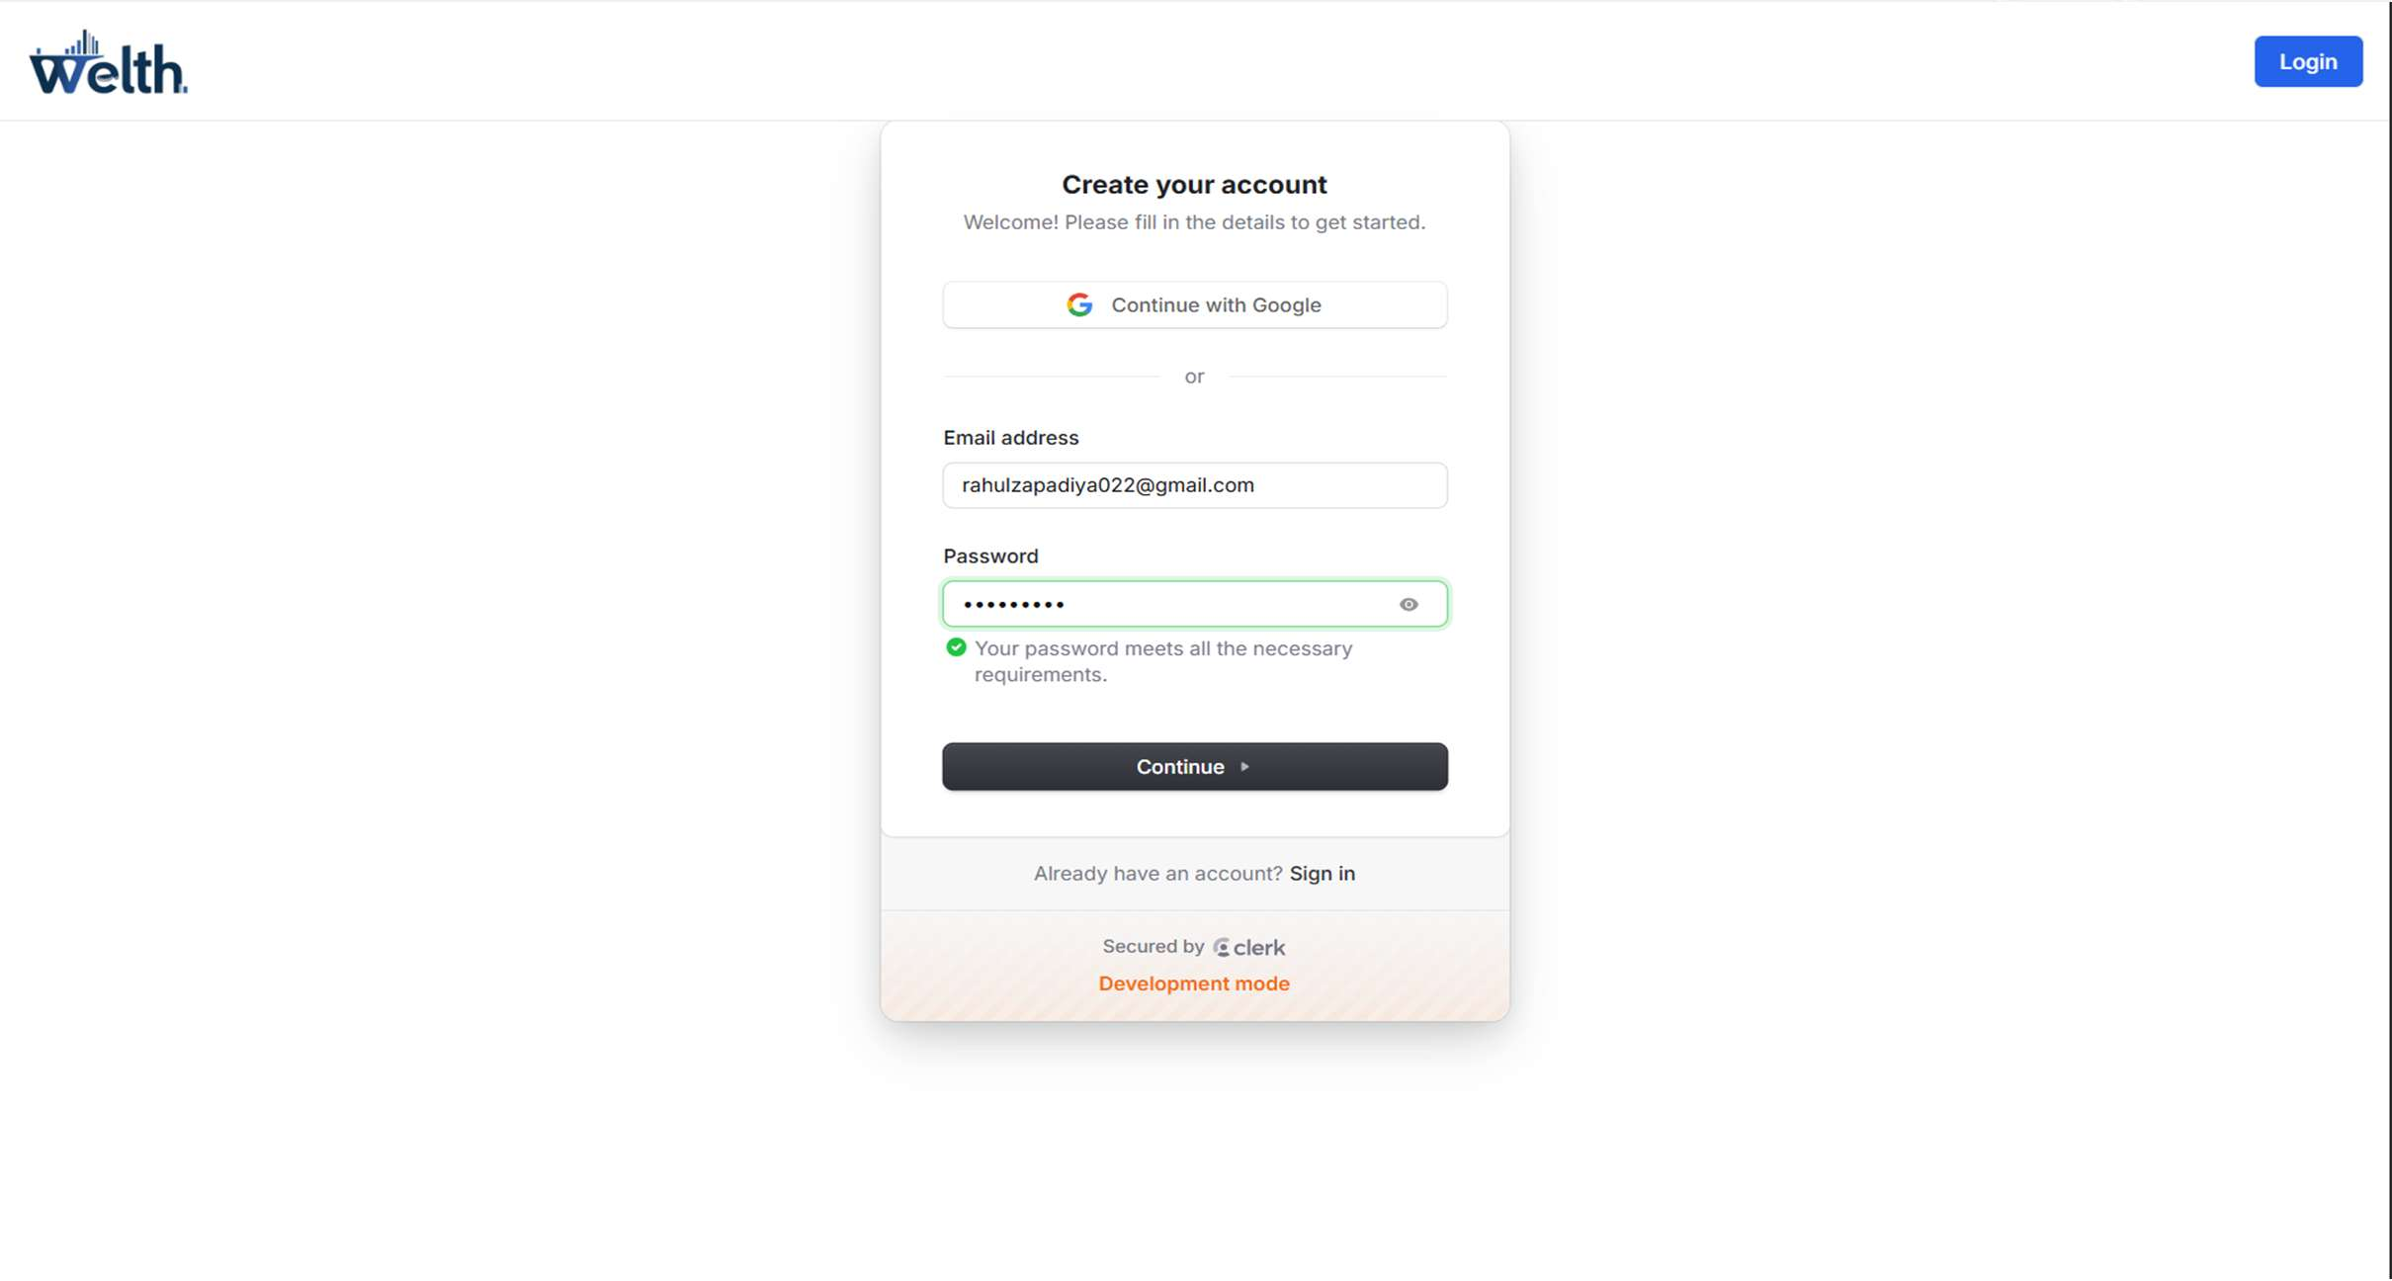
Login page
22
Description: - The Welth Login page features a clean interface with the platform logo at the top left. Users can sign in either through Google authentication or by entering their email address. The page includes a Welcome message, a prominent continue button, and an sign up for a new Users. The authentication is secured by Clerk, as indicated at the bottom of the login card.

Slide 23
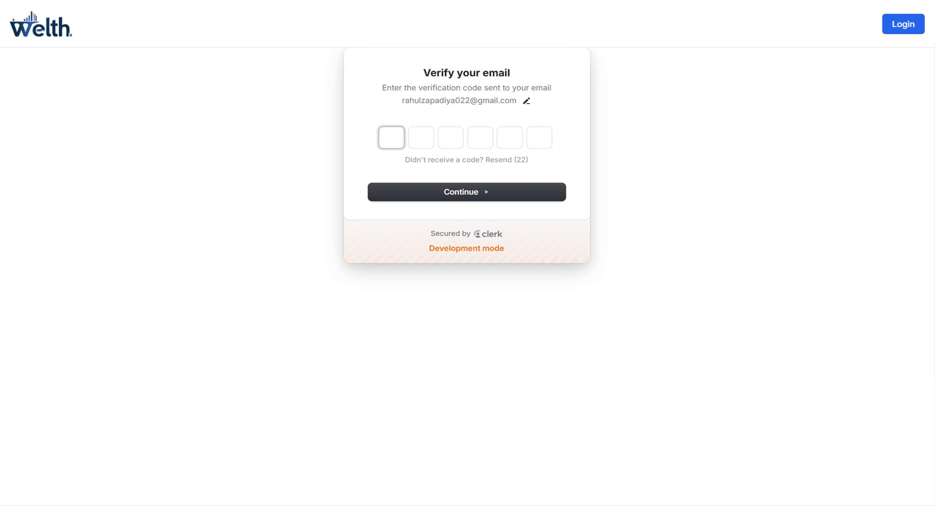
Description: -
The Welth Email Verification page presents a minimal and professional layout. At the top, the Welth logo is placed on the left, while the Silver Oak University emblem is on the right. the page is in development mode

Slide 24
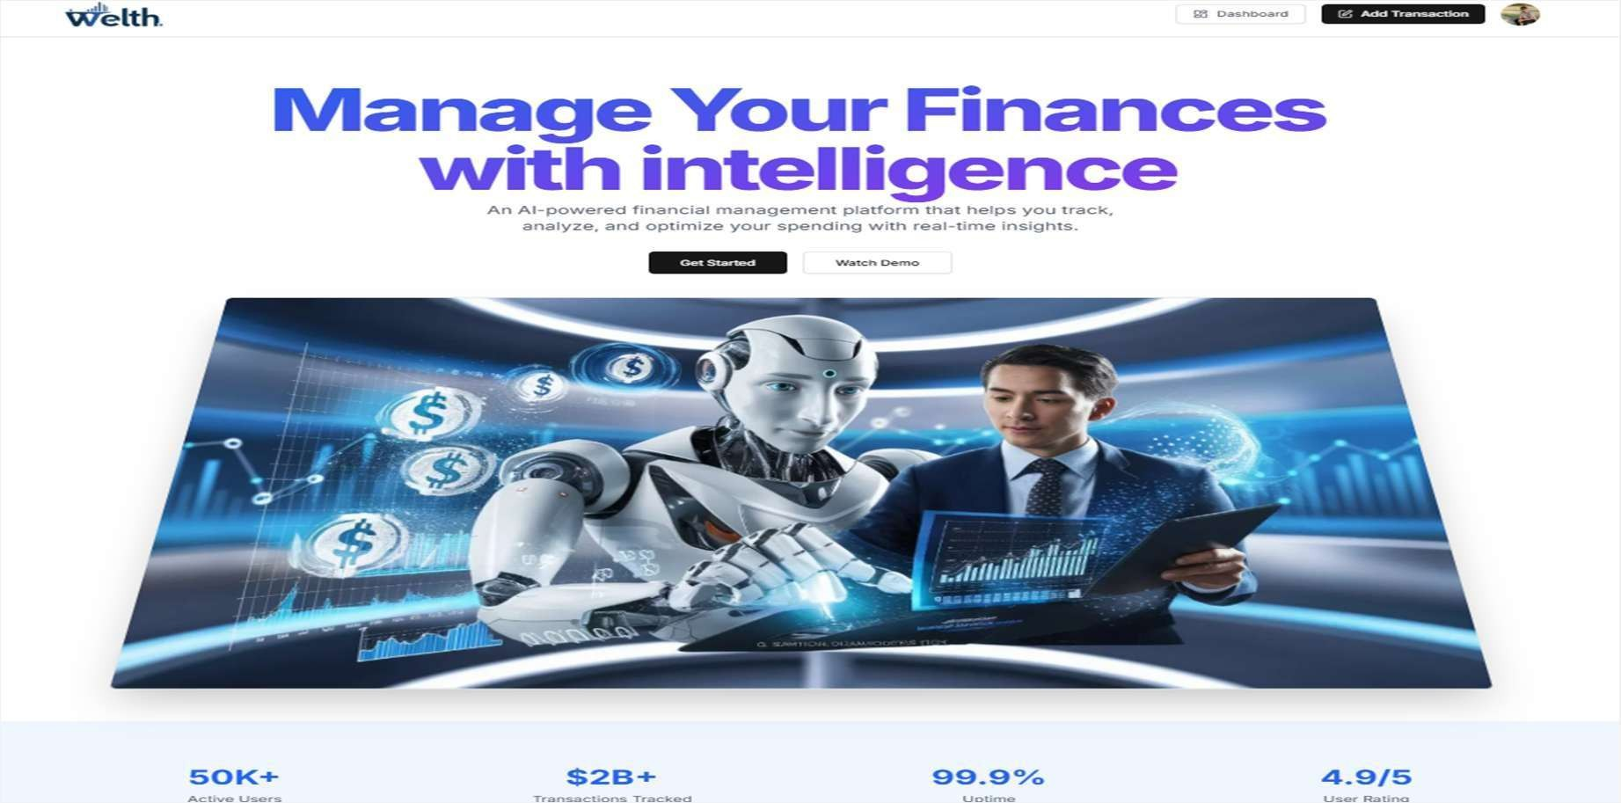
After Login Interface
Description: - This is Our After Login website Interface In Our finance App.

Slide 25
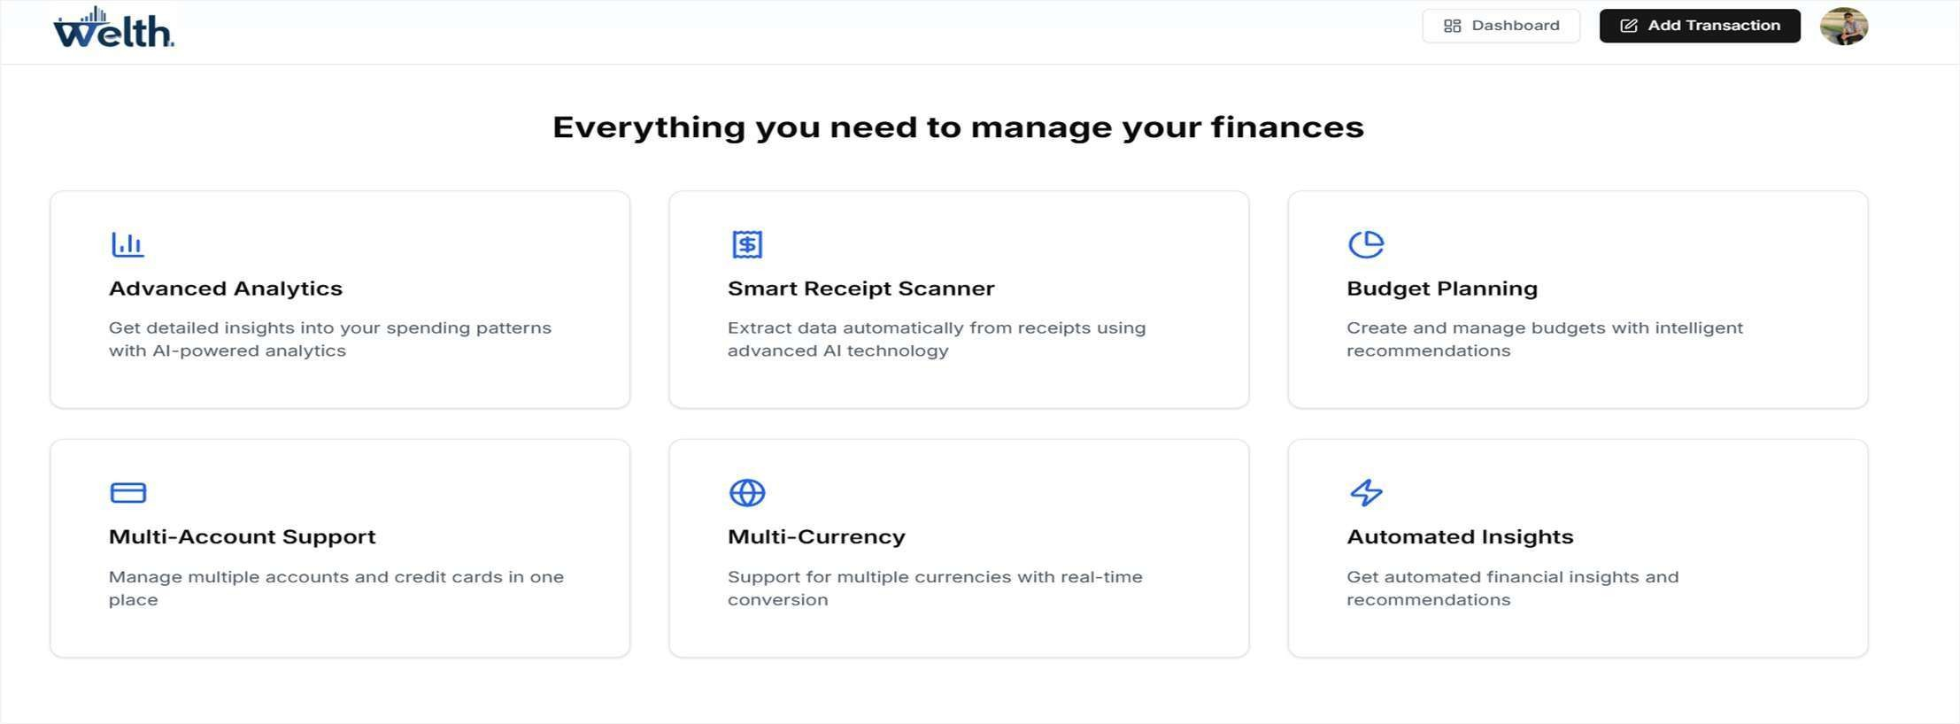
Features In Website
Description: - The Welth platform showcases six key features: Advanced Analytics for spending insights, AI Powered Receipt Scanner, Intelligent Budget Planning, Multi-Account Supports, Multi Currency capabilities, and Automated Insights that deliver Personalized financial recommendations all Presented in a clean, user-friendly grid layout.

Slide 26
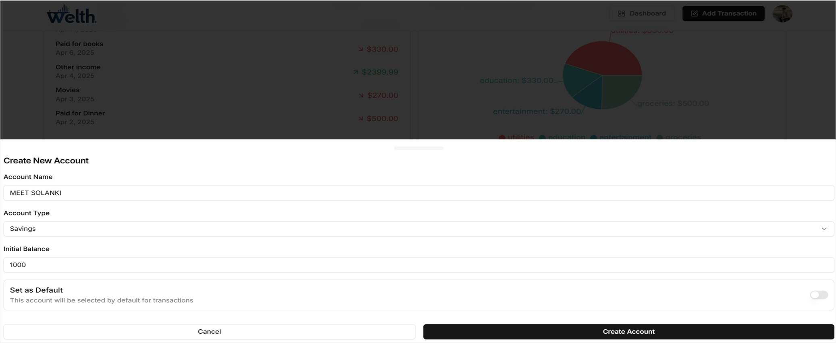
Create Account Page
Description: - The “Create New Account” section providesoptions for setting up either a Current Or Savings account in welth platform. Users can name their account, select account type form the dropdown menu, set an initial balance, and choose whether to make it the default accounts for transactions. This functionality allows users to Organize their finances by account type for better financial management.

Slide 27
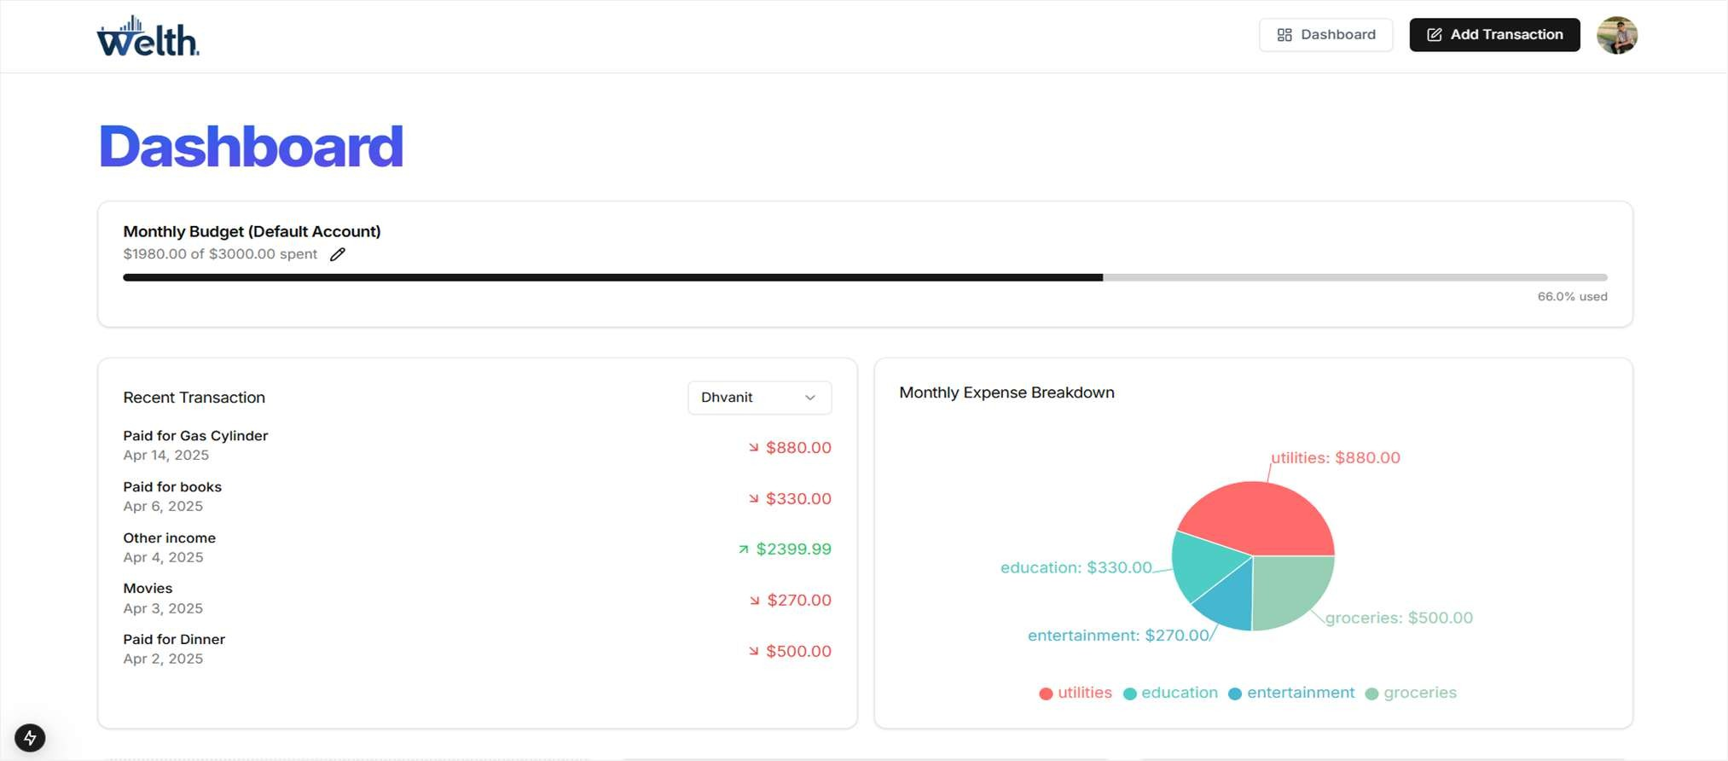
Dashboard Page
Description: - It is our Dashboard page that user can create and manage their account.

Slide 28
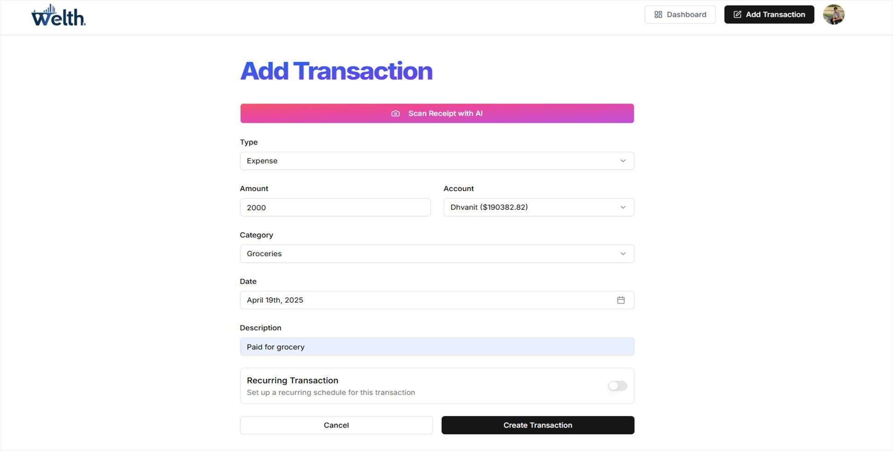
Add Transaction Page
Description: - The “Add Transaction” page provides a user-friendly interface for recorfing financial activities in the Welth Platform. Users Can either manually input transaction details(type, amount, account, category, date, and description) or use the “Scan Receipt With AI” features for automated data extraction. The page also includes an option to set up recurring transaction for regular payments or income.

Slide 29
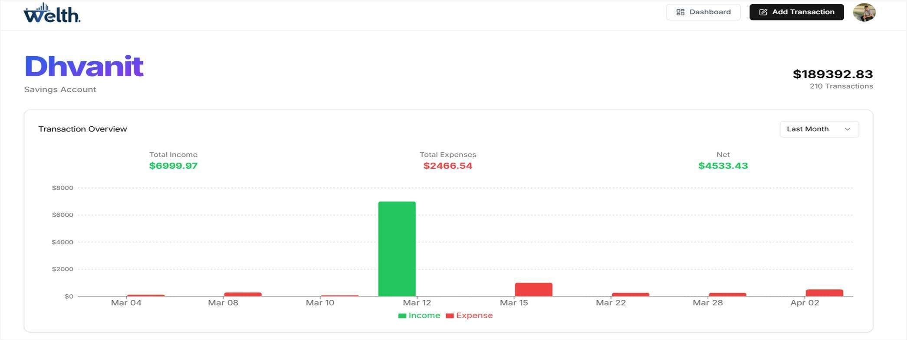
Account Page
Description: - Its Our Account page user can see their transactions and statements.

Slide 30
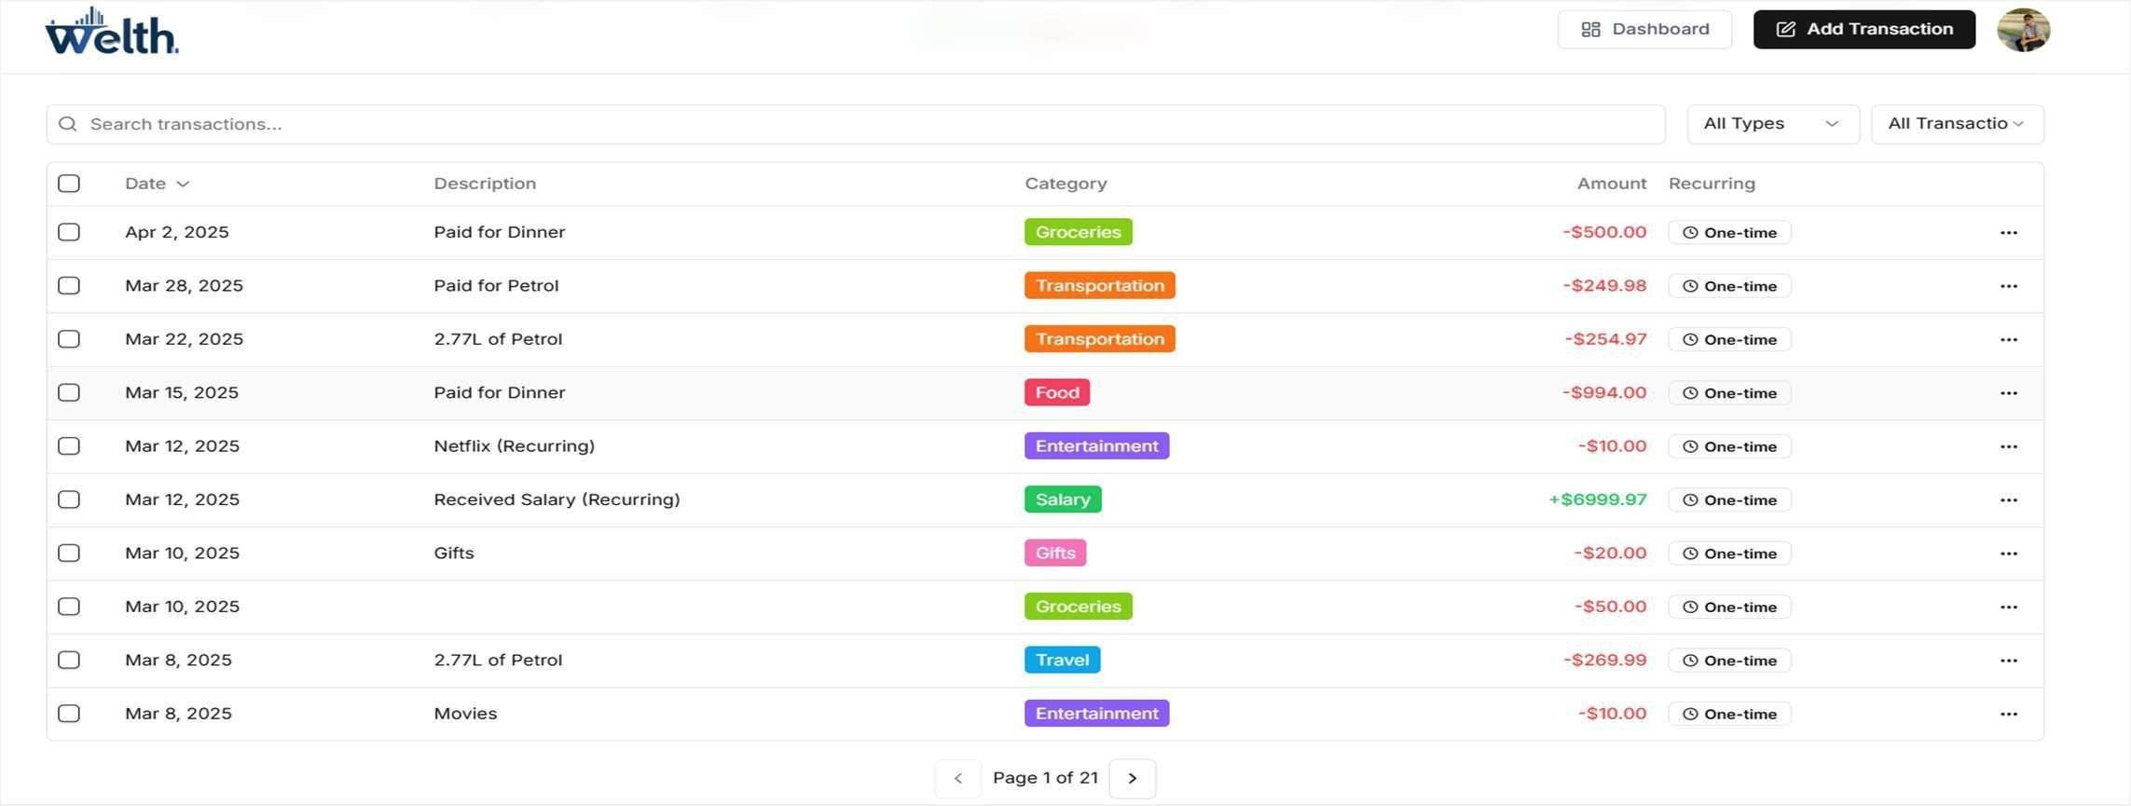
Transaction Statement Overview
Description: - The transaction records view in welth finance platform displays a clean, tabular list of financial activities with date, description, category, and amount columns. Users can see their expenses(Marked in red with minus signs) and income(in green with plus signs), with color-coded categories for easy identification. The interface also includes search functionality and filtering options to help users track their spending patterns.

Slide 31
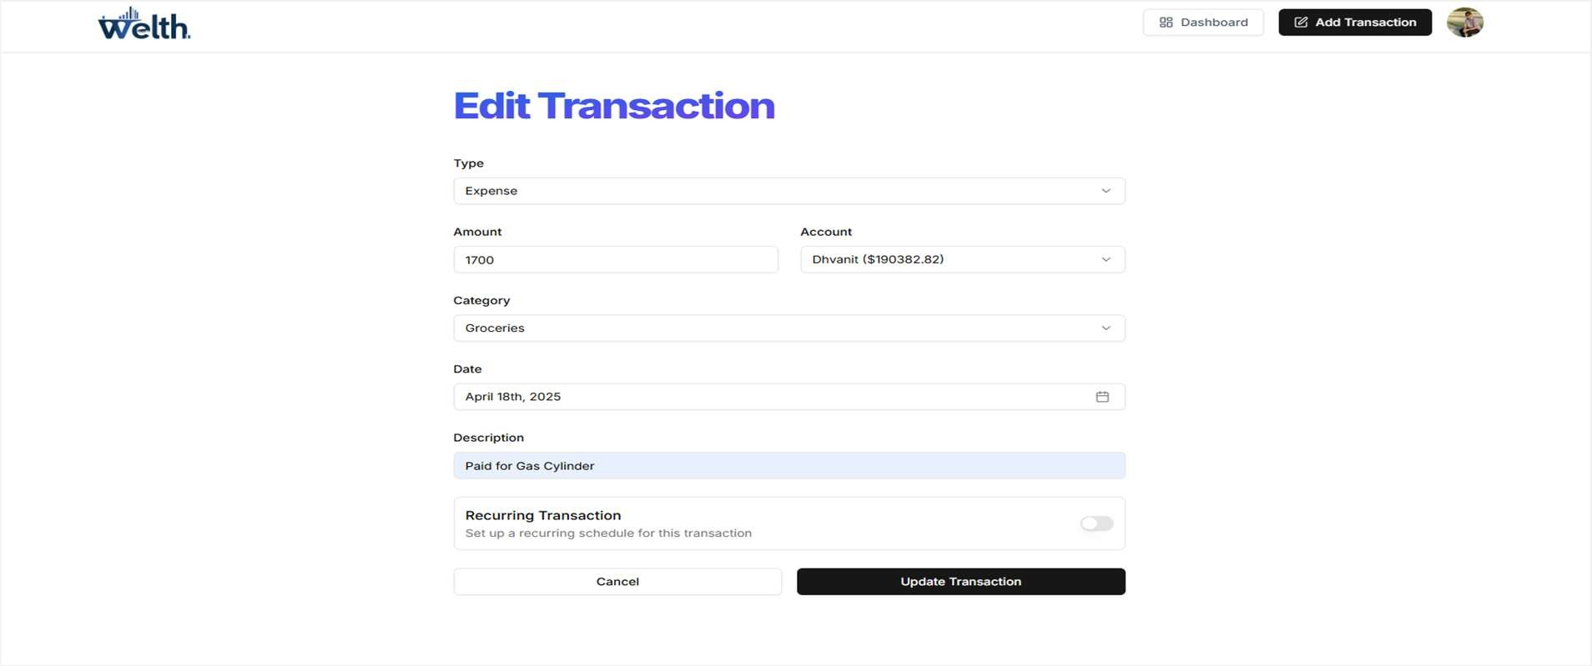
Edit Transaction page with validation
Description: - It is edit Transaction page with validation. User Can easily Edit their transaction Whenever in future if they want to change.

Slide 32
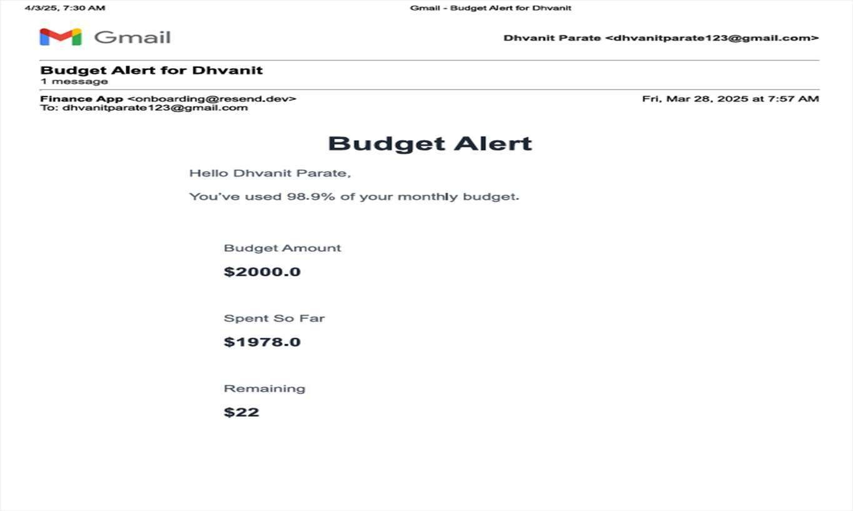
Budget Alert
Description: - This email shows an automated budget alert form welth platform senrt to Dhvanit Parate warning that they’ve used 98.9% of their monthly budget. The alert provides clear financial information showing the total budget amount(2000), the amount spent so far (1978), and the remaining balance (22). This notification helps users track their spending and avoid exceending their predetermined budget limits.

Slide 33
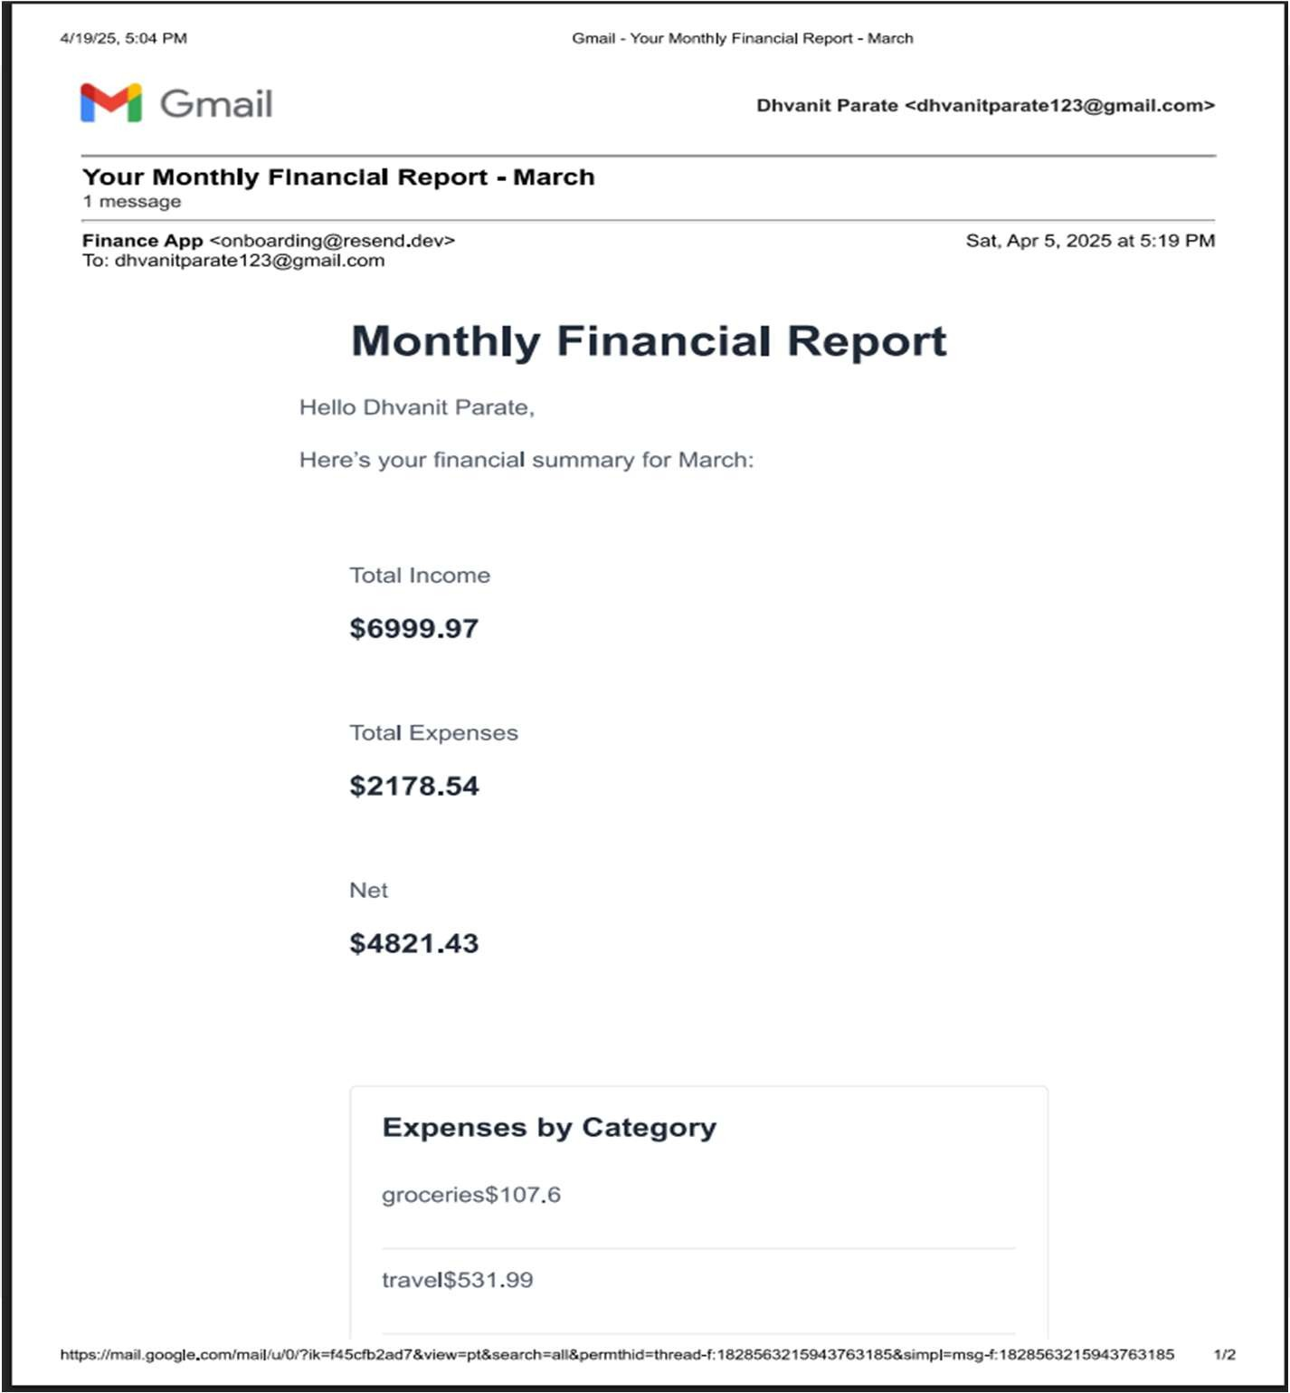
Monthly Financial Report

Slide 34
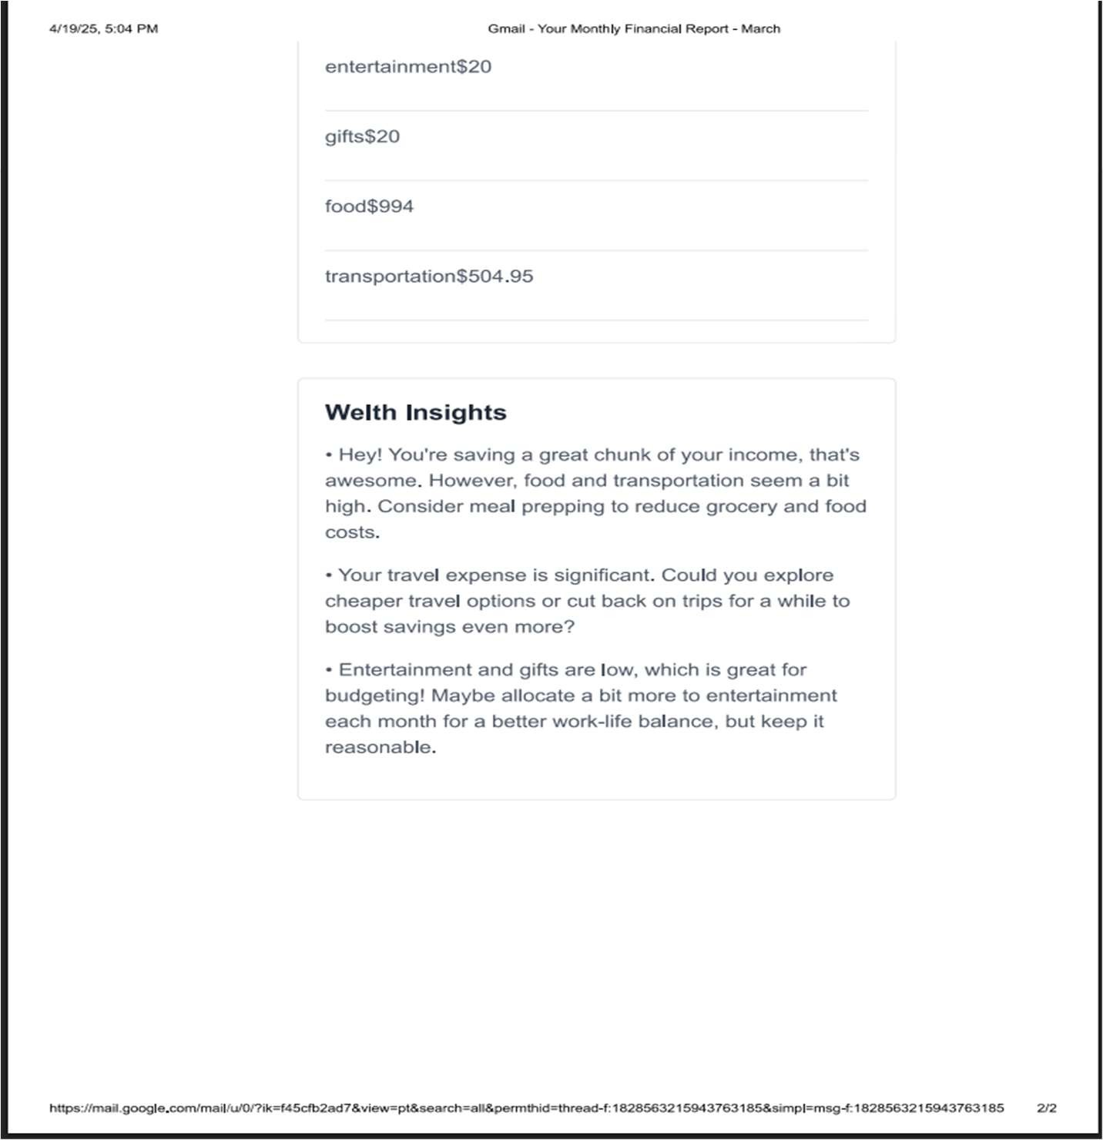
A quick glance at how money flowed in and out during March — tracking earnings, spending, and where it all went!
From groceries to travel, every dollar spent is categorized. Income far outweighed expenses, leading to healthy savings. This snapshot helps build better financial habits month by month.

Slide 35


11. TESTING
No | Test Condition | Description | Expected Result | Actual Output | Status
1 | User Registration | Register with valid credentials | User account created successfully | As expected | Pass
2 | Receipt Scanning | Scan receipt with clear text | Transaction data extracted correctly | As expected | Pass
3 | Transaction CRUD | Add, edit, delete transactions | Operations performed successfully | As expected | Pass
4 | Budget Setting | Set monthly budget | Budget created successfully | As expected | Pass
5 | Budget Alert | Exceed 80% of budget | Alert email sent | As expected | Pass
6 | Monthly Report | End of month report generation | Report generated and sent | As expected | Pass

Slide 36
12. FUTURE ENHANCEMENT
Mobile application development.
AI-powered spending insights and recommendations.
Advanced financial analytics and forecasting.
Expense sharing functionality for groups.
Investment tracking and recommendations.
Multiple currency support.

Slide 37
Financial Software & App References
Flowlu - Online Work Management Software for Teams
Quicken Personal Finance and Money Management Software | Quicken
Money Manager & Budget Planner | Spendee
EveryDollar – Ramsey
Best Home Budget App for Android, iPhone, & Web | Goodbudget

Slide 38
13. BIBLIOGRAPHY
Next.js Documentation: https://nextjs.org/docs
React Documentation: https://reactjs.org/docs
Supabase Documentation: https://supabase.io/docs
Clerk Documentation: https://clerk.com/docs
Arcjet Documentation: https://docs.arcjet.com/
Google Gemini API Documentation
Tailwind CSS Documentation: https://tailwindcss.com/docs
Shad cn UI Documentation: https://ui.shadcn.com

Slide 39
THANK YOU

